Slide 1
Fraud Targeting the Elderly:
How to protect yourself!
Presented by Catoosa County Probate Judge
Jeff Hullender

Slide 2

Look out for Common Scams
Criminals target older victims.
Methods:
  phone calls
  unexpected texts or emails
  online dating services
  being approached in public (church, restaurant)
  strangers knocking on your door

Slide 3

Elements of a scam
Urgency – it has to be now!
Emotion – fear, love, excitement
Secrecy – don’t tell anyone!

Slide 4

Grandparent Scams
“Help me, Grandma. I’m in jail.”
“Don’t tell my parents!”
“I’m scared – please send money.”
THIS Don’t pay them – call your family!

Slide 5

IRS Scams
“This is the IRS.”
“You owe us money.
“The police are on their way to arrest you,
unless you pay us now!”
The IRS never calls taxpayers.

Slide 6


Sweepstakes Scams
“You’ve won a big prize.”
“You have to pay the (taxes) (shipping) first.”
“Wire the money/send cash/buy gift cards.”
You never have to pay to receive a prize.

Slide 7

Store Scams
Senior discount day
Distractions
  “Do you think my mom would like this shirt?”
  “Can you help me read this label?”
  Somebody drops something in front of you.
  Pickpockets often work in pairs.
  Don’t put your wallet in your back pocket.
  NEVER leave your purse in the shopping cart.

Slide 8

Home Repair Scams
A stranger tells you there is a problem with:
  your roof,
  your driveway,
  tree limbs, or
  they will offer to power-wash your house.
Only hire a company that you know, or who is referred by someone you know.
Don’t hire someone who knocks on your door.

Slide 9

Investment Fraud
BEWARE of these claims:
  guaranteed profits
  no risk
  profits of 30%, 100% or higher
  offers that are “only available today”
  secret investments – just for you.
If it sounds too good to be true – IT IS! !

Slide 10

Computer Repair Scams
“This is Microsoft – you have a problem with your
computer.”
Never give remote access to someone who calls you. It’s a lie.
They can clean out your bank account.
If you have a computer problem,
ask someone you trust, or go to a store.

Slide 11

Romance Scams
Warning signs: he/she
- lives far away – can’t meet in person
- asks you to sign legal documents
- says their mother needs surgery
- asks for your credit card number
- needs money to travel for a sick relative
- needs you to wire money, or buy gift cards.
They could be lying about who they are,
and that means you will never get your money back.

Slide 12
What Can You Do?

Slide 13
Just HANG UP!
Telemarketers act friendly to make it hard
for you to end the call.
Just say “no, thank you” and hang up.
No legitimate business will rush you or threaten you
to make a decision.

Slide 14
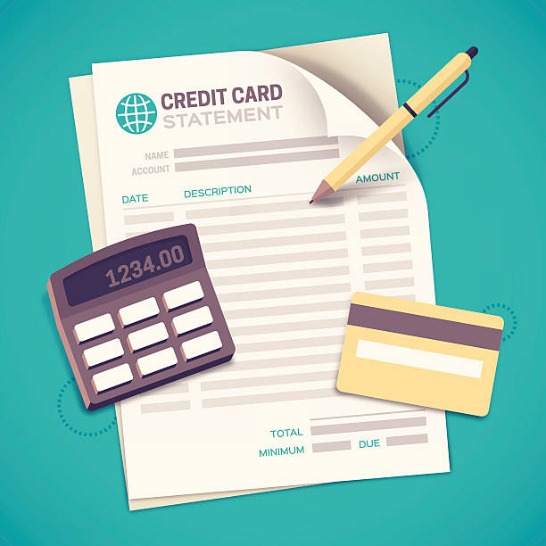
Read Your Statements
  Read your bank/credit card statement every month.
  If you find unauthorized transactions,
    file a complaint, and
    get a new card,
    or open a new account.
If you don’t report fraud promptly, you won’t get a refund.

Slide 15

Guard your Information
DON’T give your account numbers or social security number to anybody who calls you on the phone.
They will claim to be:
  utilities – gas, electric
  a charity,
  Social Security, or
  your bank or credit card company.
Hang up and call the company yourself.

Slide 16

Red Flags
A request to deposit money into your account
A request for you to cash a check (and keep a small amount)
Request for payment in:
  Gift cards
  Crypto currency
  Bank transfers
Request for secrecy
Urgency - act now!

Slide 17

“DO NOT CALL” Registry
Reduce the number of telemarketing calls you receive.
1-888-382-1222
www.donotcall.gov

Slide 18
Contact Information
Fraud Counseling - www.aarp.org/fraudsupport
Senior Legal Hotline – 404-657-9915
  Free legal advice, M-Thursday 9:00 to 2:00
Adult Protective Services – 1-866-552-4464
  To report suspected abuse, neglect or exploitation
Better Business Bureau – 404-766-0875
  Research a business before hiring them

Slide 19
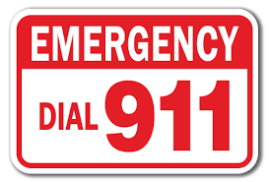
And Don’t Forget…
If you ever feel threatened, call the police.

Slide 20
catoosa.com/probate
Presented by the Catoosa County Probate Court

